Slide 1
Learning ASP NET CORE 3.1 Web API
Maruti Makwana
Microsoft Certified Trainer

Slide 2

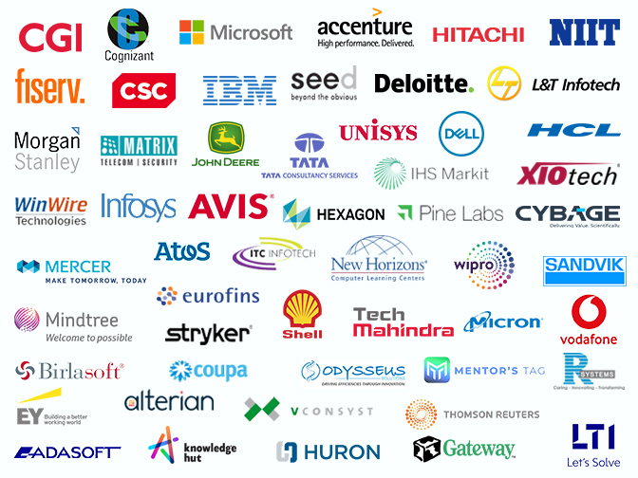

Maruti Makwana
MICROSOFT CERTIFIED TRAINER

Slide 3
Azure
Dot Net Core
Dot Net
Pipeline
Ado.Net
MVC
Code First
approach
C#
Middleware
async & await
SQL
Dependency
injection
LINQ
TAG Helper

Slide 4
What is ASP.Net Core?
How it is different from
ASP Dot Net Framework?

Slide 5
What is ASP .Net Core?
ASP.NET Core is an open source and cloud-optimized web framework for developing modern web applications that can be developed and run on Windows, Linux and the Mac.
It includes the MVC framework, which now combines the features of MVC and Web API into a single web programming framework.

Slide 6
Why to choose ASP. Net Core?
ASP.NET Core is an open source and cloud-optimized web framework for developing modern web applications that can be developed and run on Windows, Linux and the Mac.
It includes the MVC framework, which now combines the features of MVC and Web API into a single web programming framework.
ASP.NET Core apps can run on .NET Core or on the full .NET Framework.
It was architected to provide an optimized development framework for apps that are deployed to the cloud or run on-premises.

Slide 7
Why to choose ASP. Net Core?
ASP.NET Core apps can run on .NET Core or on the full .NET Framework.
It was architected to provide an optimized development framework for apps that are deployed to the cloud or run on-premises.
Built-in support for dependency injection.
Tag Helpers which makes Razor markup more natural with HTML.
The benefits of a smaller app surface area include tighter security, reduced servicing, improved performance, and decreased costs

Slide 8
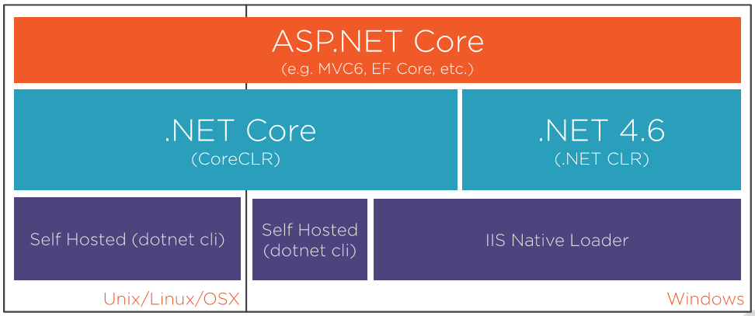

Slide 9
What is MVC?
MODEL
VIEW
CONTROLLER

Slide 10
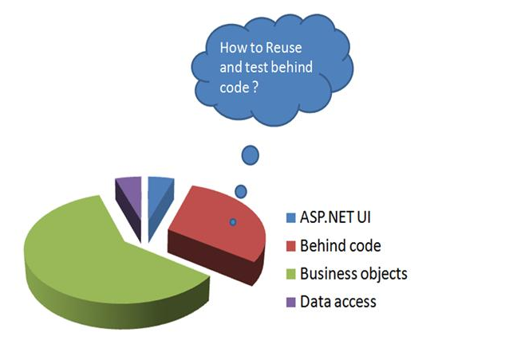
Why MVC ?

Slide 11
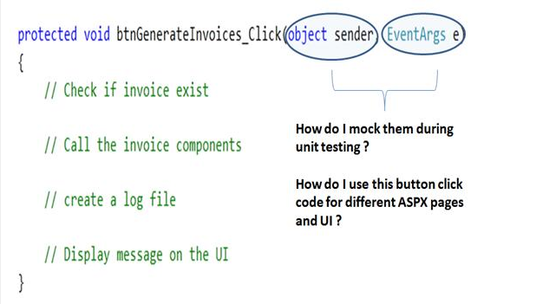

Slide 12
What is difference between Asp.Net Web application and MVC web application?

Slide 13
What is MVC 6?
Which is based on dot net core framework
NOT on dot net framework

Slide 14
Can I develop MVC 6/Dot net core application
Without Visual studio?
Yes BUT----- nobody is doing like that

Slide 16
Before ASP.Net Core let’s See.Net Core

Slide 17
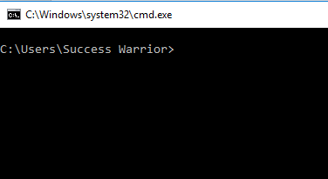
Let’s Understand dotnet code with simple application
Open
Command
prompt

Slide 18
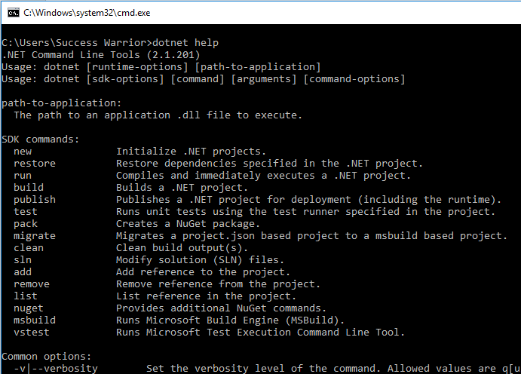

Slide 19
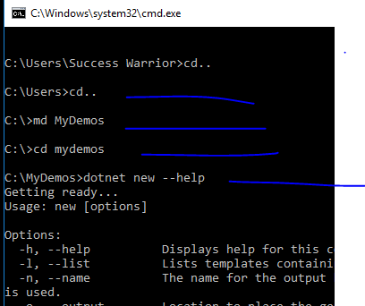

Slide 20
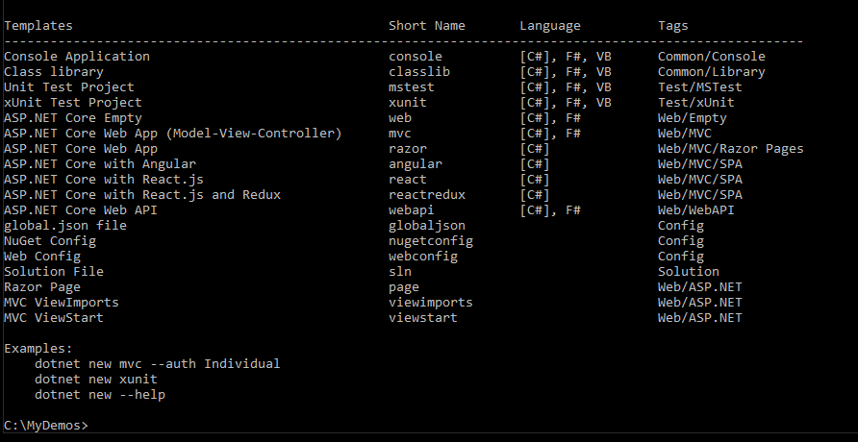
We can create any of these projects using dotnet command

Slide 21
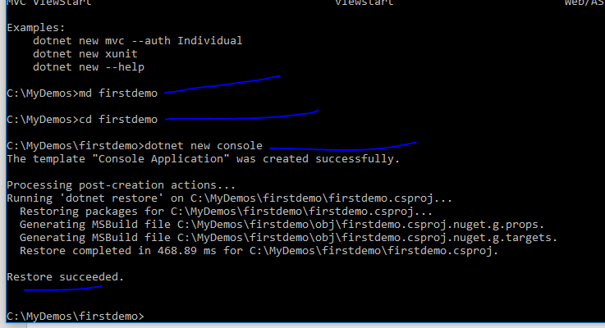
We created new console applicaiton

Slide 22
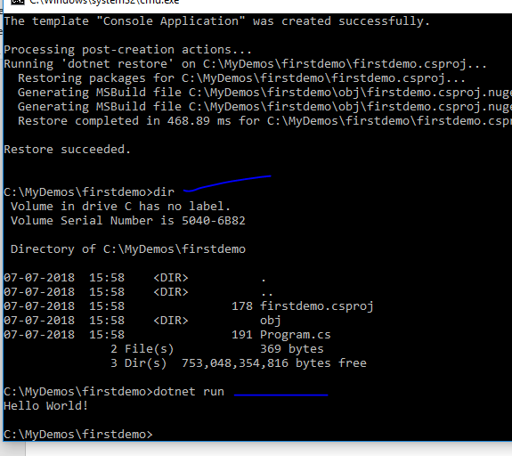
We got new project with very simple project
And its running

Slide 23
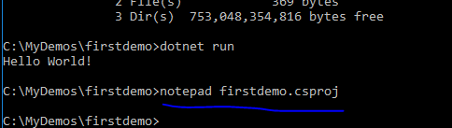
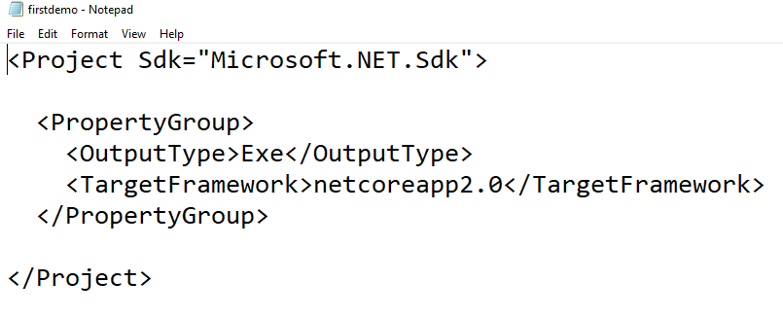
A very simple
csproj file

Slide 24
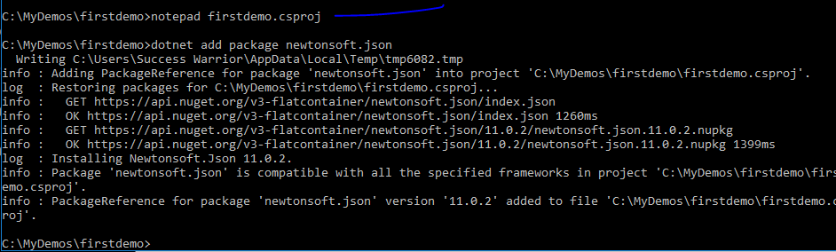
Adding new package using npm

Slide 25
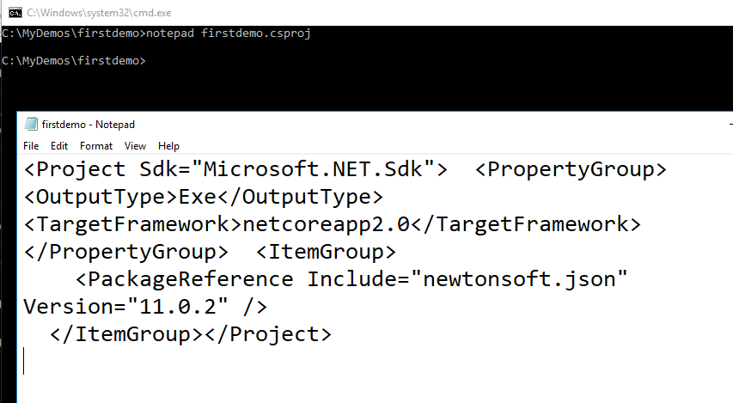
Csproj file will get changed and package is added

Slide 26
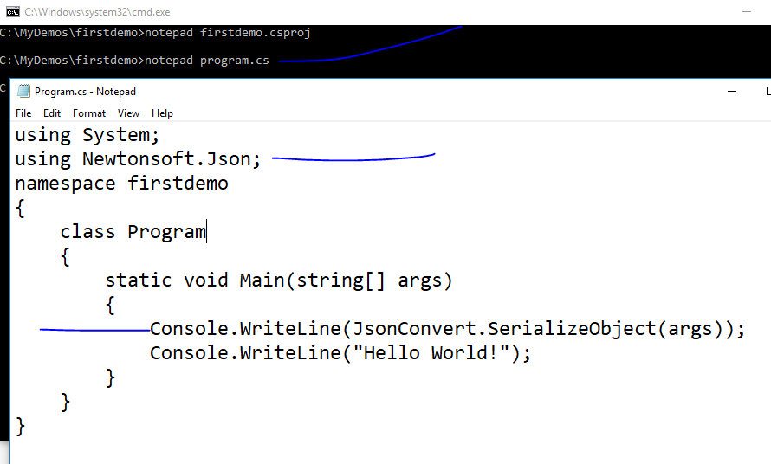

Slide 27
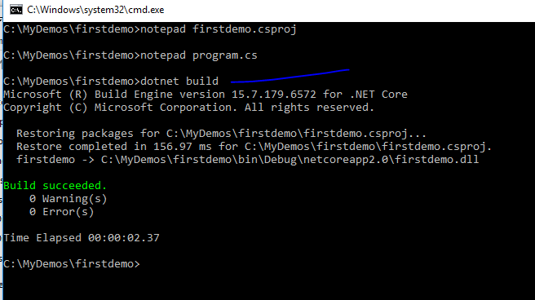

Slide 28
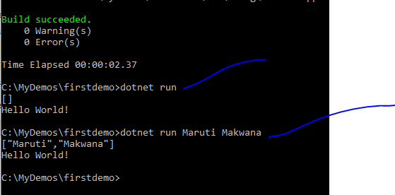

Slide 29
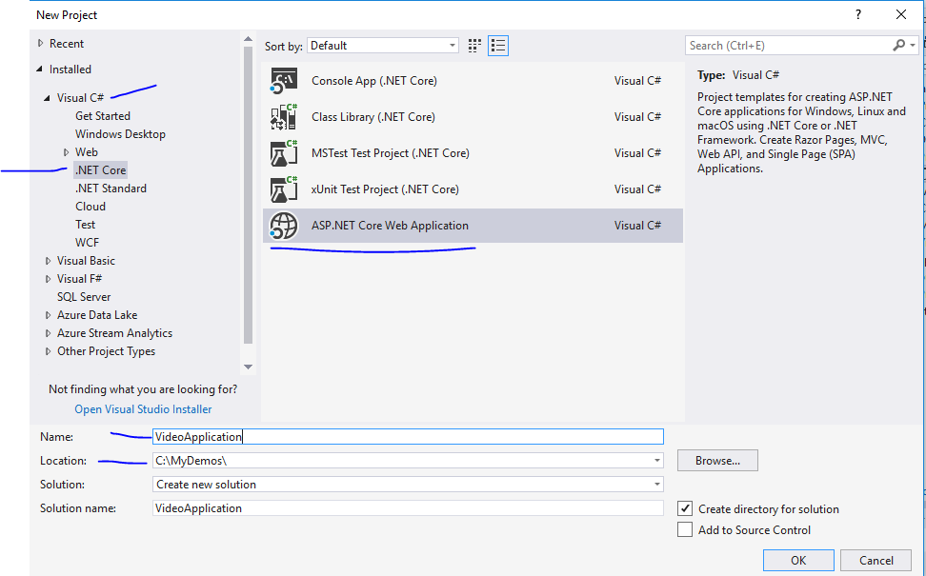

Slide 30
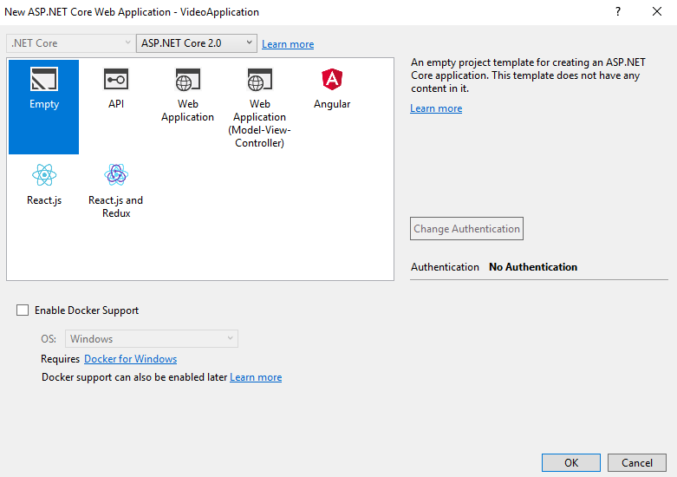

Slide 31
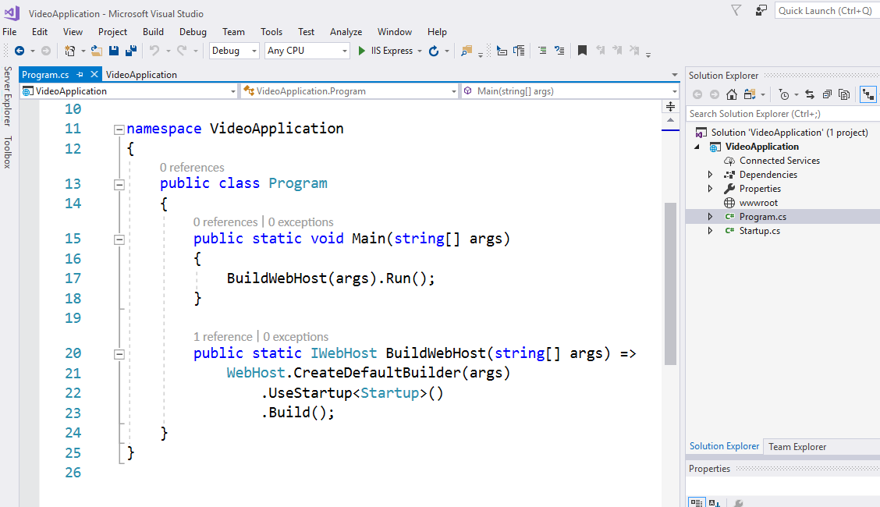

Slide 32
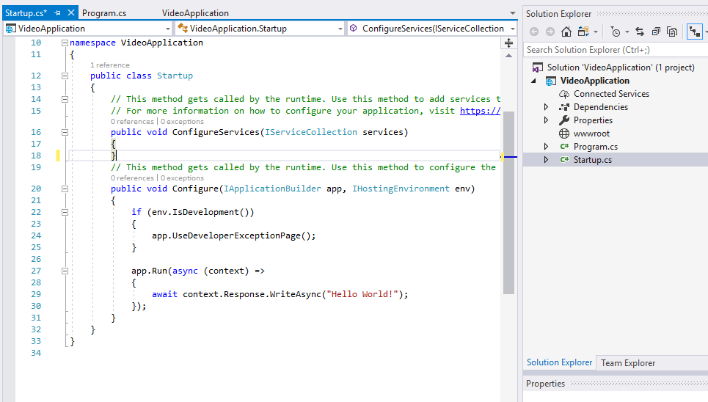
For any request that comes in just write out helloworld

Slide 33
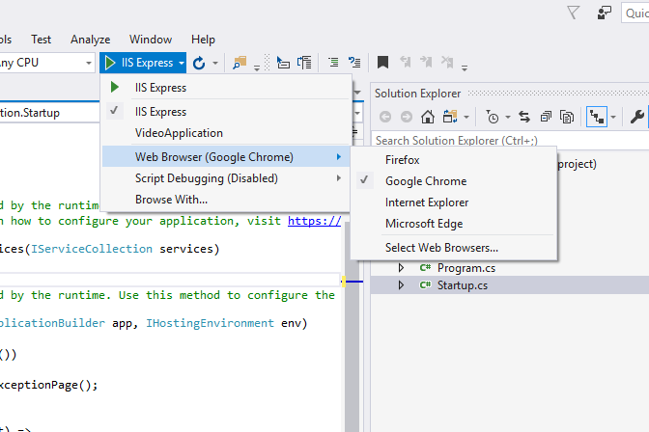

Slide 34
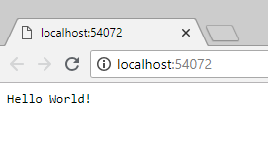
Even if you check view source this is just text
Which we are returning – No html page till now

Slide 35
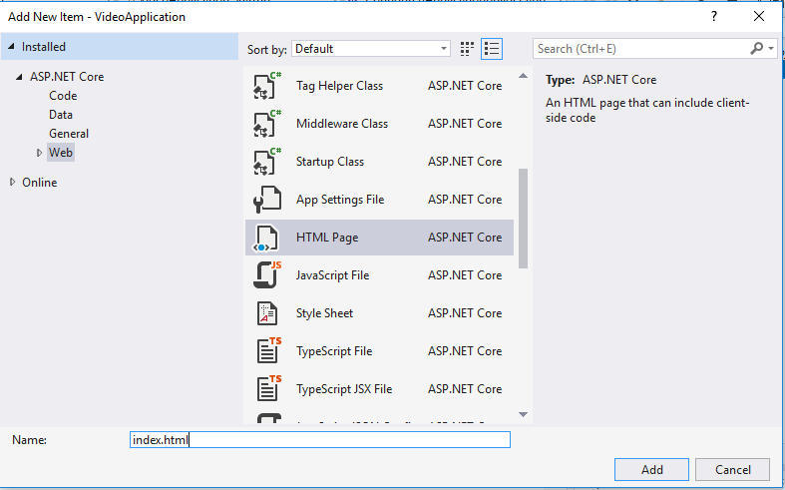

Slide 36
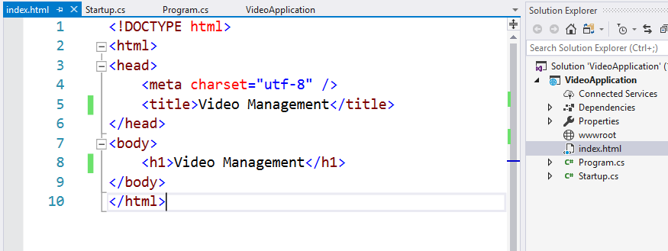

Slide 37
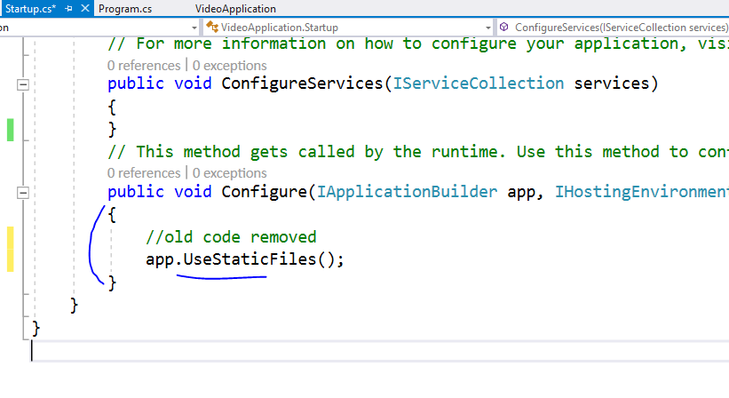

Slide 38
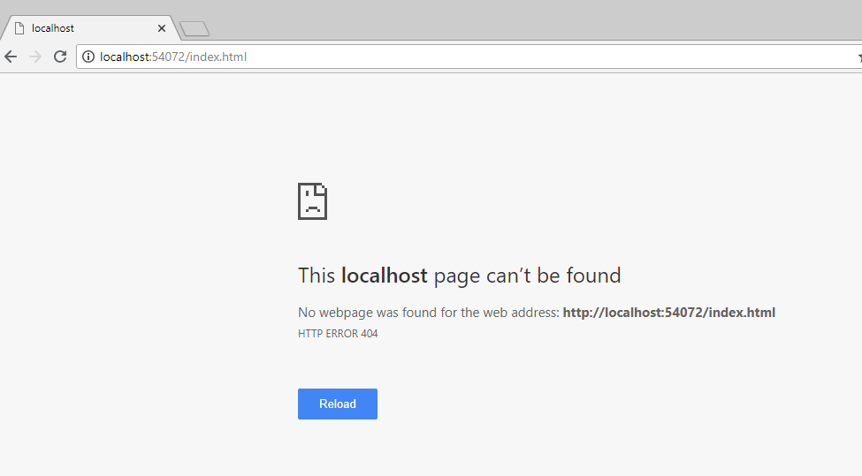
Ooops !!

Slide 40
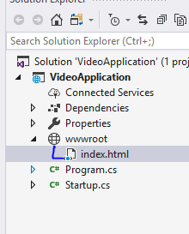
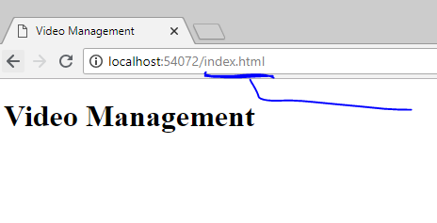
Move index file into wwwroot

Slide 41
All your JS, CSS, HTML and font files will
Always go inside wwwroot folder only

Slide 42
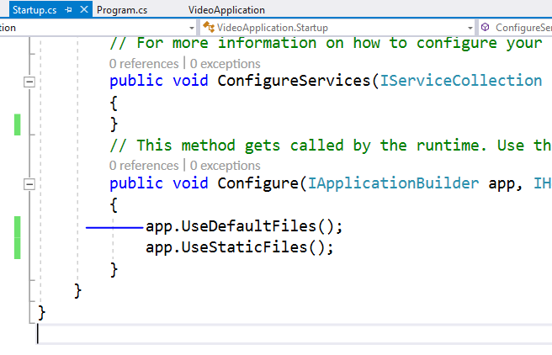
To serve html in this directory please add this
This order is important because
Middleware works based on that

Slide 43
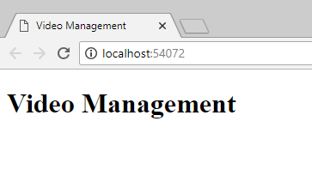
Now index page is visible on base URL

Slide 44
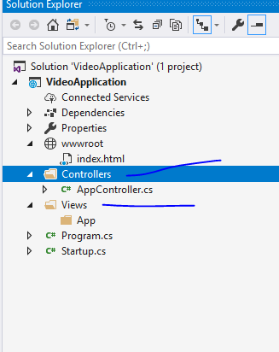
Add folders like this

Slide 45
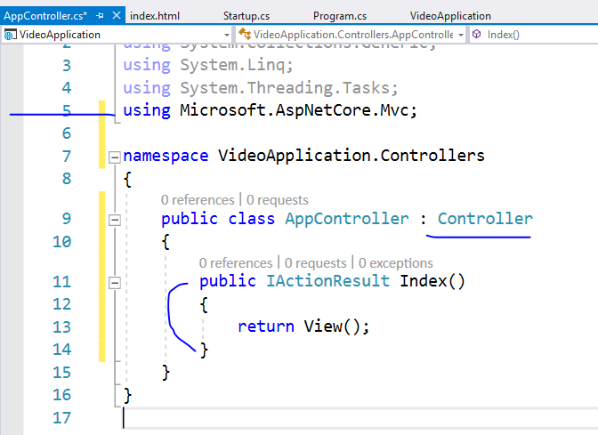
Add code
like this

Slide 46
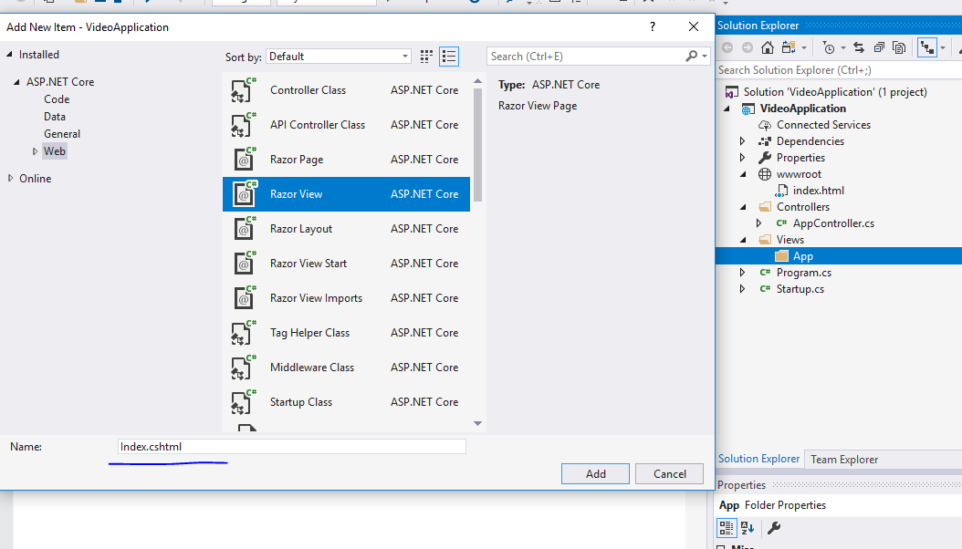

Slide 47
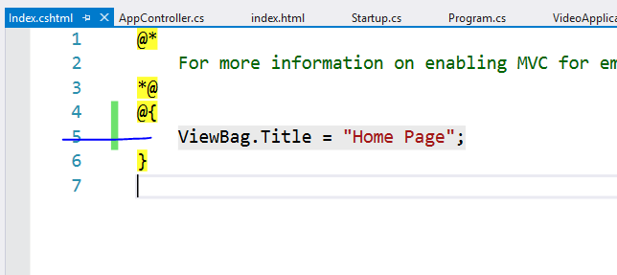

Slide 48
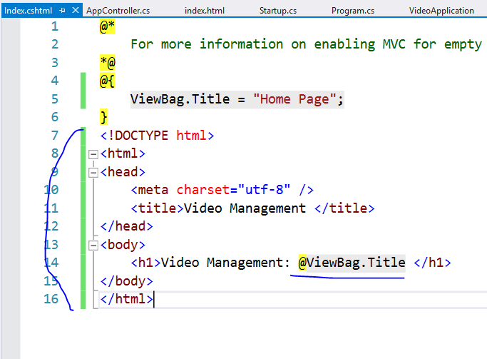

Slide 49
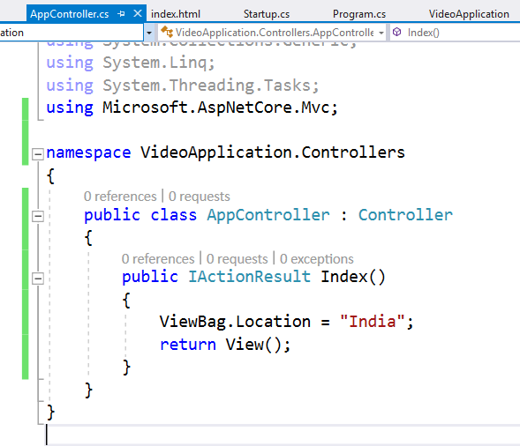

Slide 50
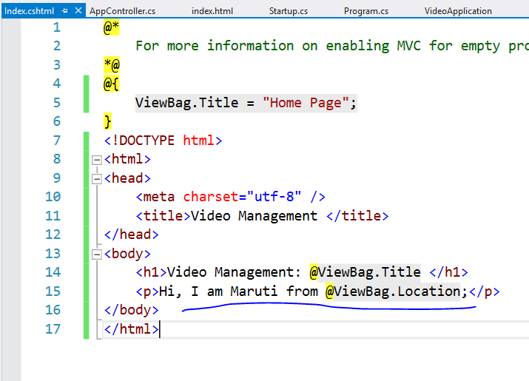

Slide 51
This will not run controller right now
Because we have not enabled MVC in this project
Let’s do it now

Slide 52
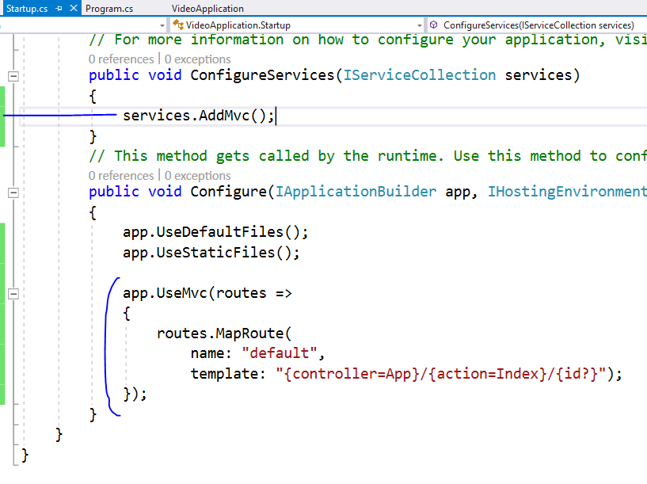

Slide 53
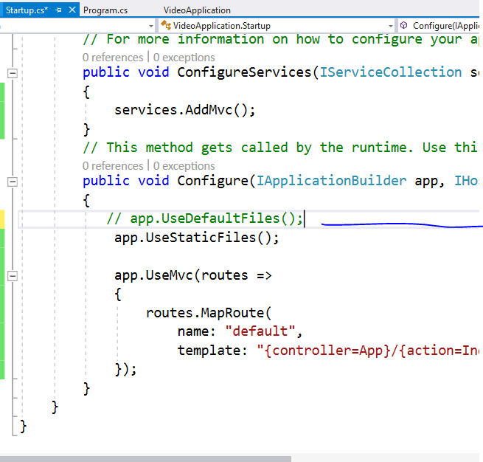
Comment this as
We don’t want to follow
File system path

Slide 54
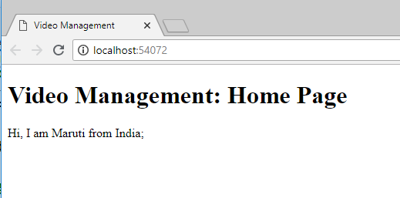

Slide 55
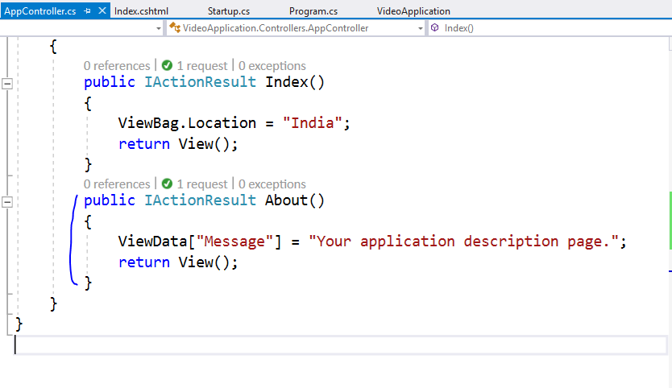

Slide 56
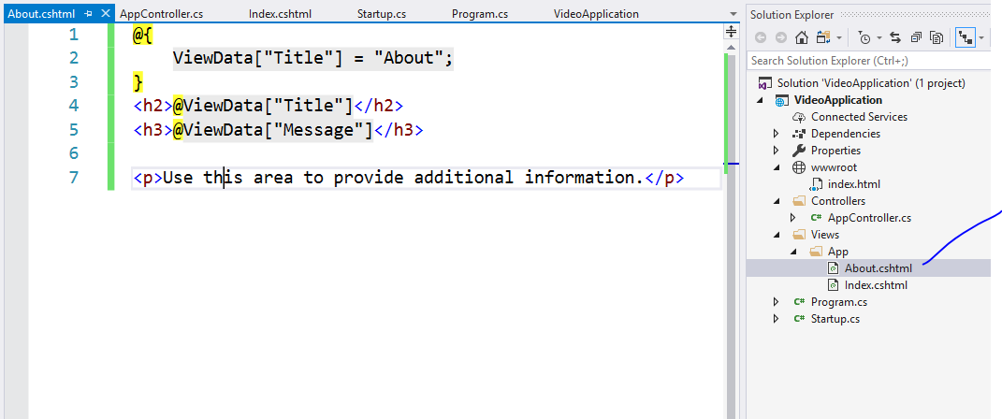

Slide 57
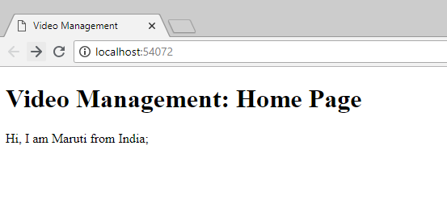
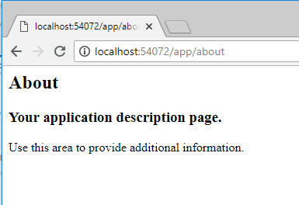
Type this url

Slide 58
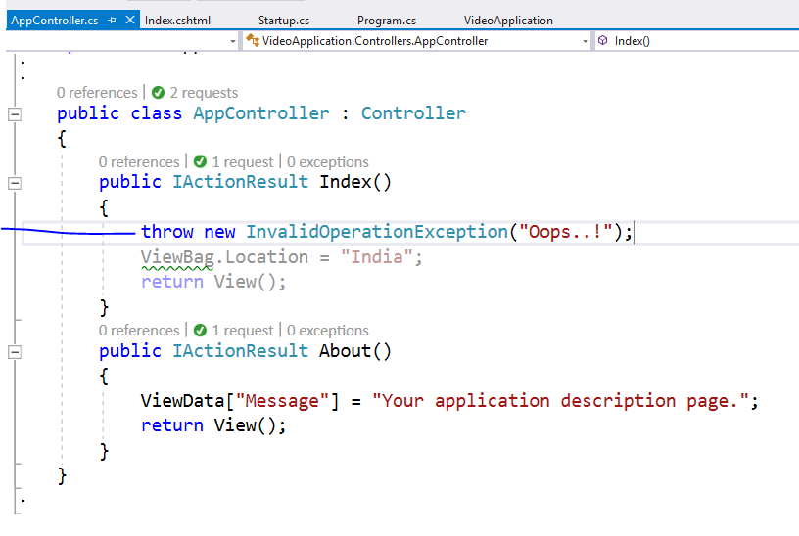
Add this line and run using ctrl + F5

Slide 59
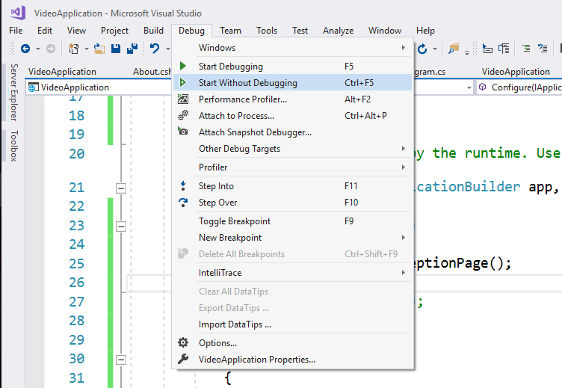

Slide 60
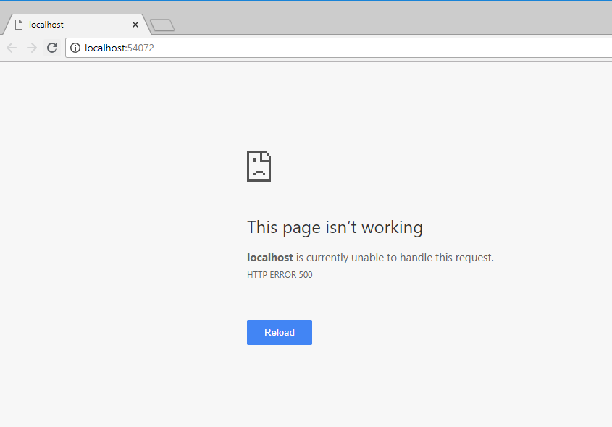
You will not get exception details

Slide 61
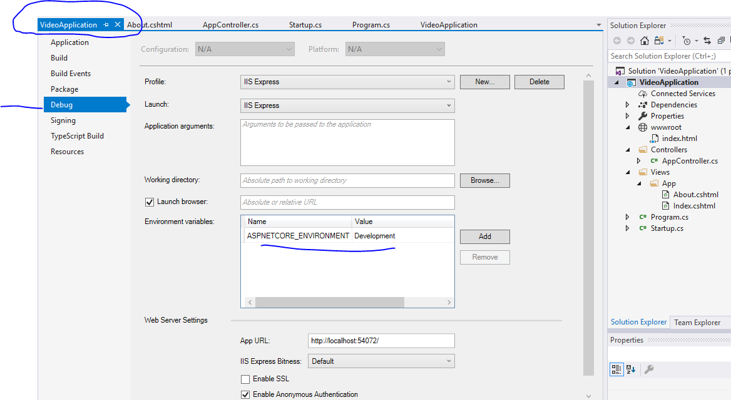

Slide 62
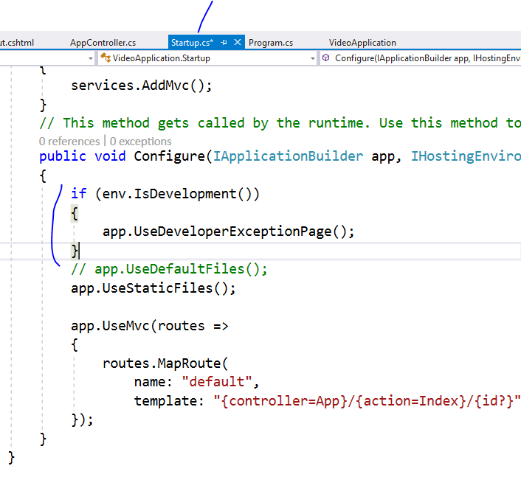

Slide 63


Slide 64


Slide 65


Slide 66


Slide 67


Slide 68

Remove extra things

Slide 69


Slide 70


Slide 71


Slide 72


Slide 73


Slide 74


Slide 75


Slide 76

Whatever you add here will be referred in
All the views

Slide 77


Slide 78


Slide 79


Slide 80


Slide 81


Slide 82


Slide 83

Change it to production

Slide 84
Now we are going to create Razor Page

Slide 85

Add new folder and new page

Slide 86

Pages do not require controllers

Slide 87



Slide 88

We added
2 contact actions

Slide 89


Slide 90


Slide 91


Slide 92





Slide 93


Slide 94


Slide 95



Slide 96


Slide 97
Now lets use tag helpers for same

Slide 98


Slide 99


Slide 100

Even if you click on lable it will
Focus on textbox because of
Asp-for

Slide 104
Validation : skip

Slide 105


Slide 106


Slide 107

If you want to display
Summary on top then
Set
Asp-validation-summary=“All”

Slide 112
S.O.L.I.D Principles
S stands for SRP (Single responsibility principle)
-Concerned about single focused purpose
O stands for OCP (Open closed principle)
-Open for extension but Closed for modification
L stands for LSP (Liskov substitution principle)
-the parent cannot replace the child object seamlessly
I stands for ISP ( Interface segregation principle)
-any Interface should not force any method to class which is implementing it
D stands for DIP ( Dependency inversion principle)
-Objects should be loosely coupled and injection should happen at runtime

